Slide 1
Information Security AI

Slide 2
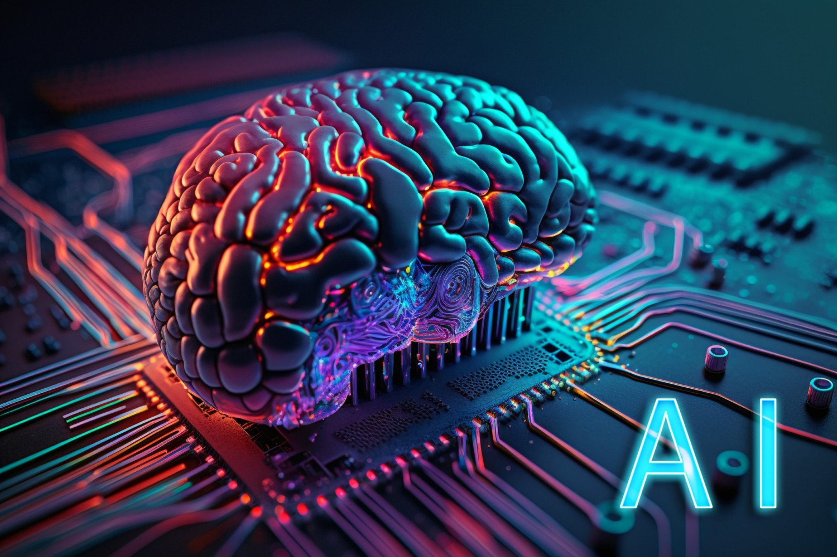
What is AI?
Artificial intelligence
The implementation of machine learning to create a machine or program capable of replicating human reasoning or intelligence.

Slide 3
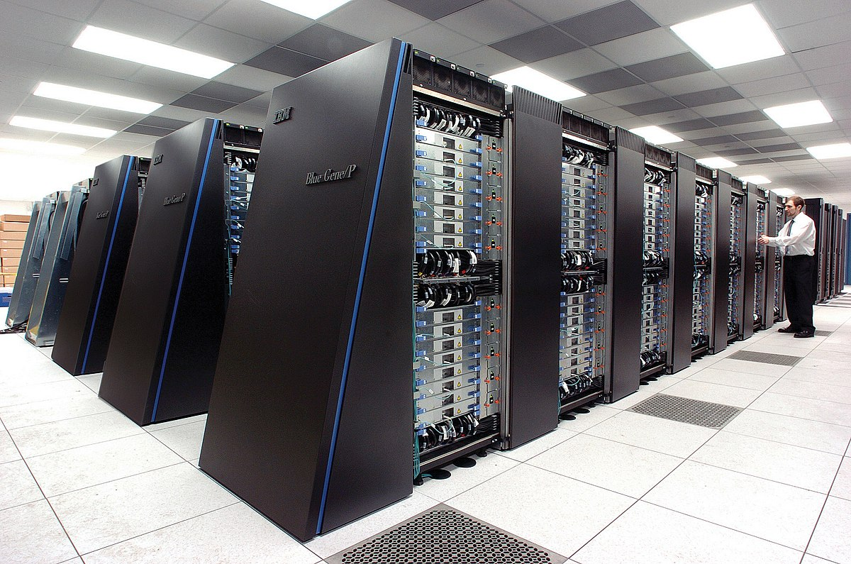
How Does AI Work?
AI is trained and/or runs on a series of machine learning algorithms that require data input. This inputted data is usually a large database used to train the AI. The AI learns from this data to be able to generate it’s own output based on what it learned form its training data. It must also learn Natural Language Processing to comprehend human language as well as speak it. This is usually accomplished by the machine learning algorithms picking up patterns in data to improve its ability to read and speak human language.
AI usually runs on a supercomputer or interconnected computer clusters.

Slide 4
AI in Information Security

